Slide 1
BANK MARKETING ANALYTICS
iNeuron
Madhav Khurana

Slide 2
OBJECTIVE :
To get insights about customers who subscribed term deposits. Insights include their demographical details and various indicators to know the customer better.
To get insights about the effectiveness of the marketing campaign on the customers. These insights help the company to take data driven decisions which will enable the bank get more revenues by acquiring more customers as well as in cost cutting.

Slide 3
DATA SHARING AGREEMENT:
Sample file name (ex bank-additional-full.csv)
Length of date stamp(8 digits)
Length of time stamp(6 digits)
Number of Columns
Column names
Column data type

Slide 4
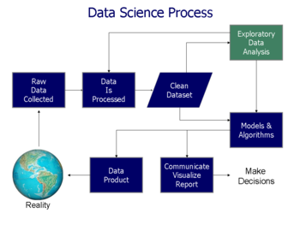
ARCHIETECTURE :

Slide 5
DATA OVERVIEW:
The zip file includes two datasets:
bank-additional-full.csv with all examples, ordered by date (from May 2008 to November 2010).
bank-additional.csv with 10% of the examples (4119), randomly selected from bank-additional-full.csv.
The smallest dataset is provided to test more computationally demanding machine learning algorithms (e.g., SVM).
The binary classification goal is to predict if the client will subscribe a bank term deposit (variable y).
Number of Instances: 41188 for bank-additional-full.csv
Number of Attributes: 20 + output attribute.

Slide 6
KEY PERFORMANCE INDICATOR:
Key indicators displaying a summary of the Bank marketing Campaign’s results and subscribers’ information based on various parameters :
1. No of Subscribers based on age range.
2. Subscriber’s demographics such as age, job, education and marital status.
3. Leads conversion rate based on various parameters
4. Credit default information and analytics
5. Employment variation rate - quarterly indicator
6. Consumer price index - monthly indicator (numeric)
7. Consumer confidence index - monthly indicator (numeric)
8. Euribor 3-month rate - daily indicator (numeric)
9. Number of employees - quarterly indicator (numeric)

Slide 7
DATAFRAMES DESCRIPTION:
df – It contains all information of people who subscribed term deposit.
Data - It contains all information of people who were contacted during the marketing campaign.
df_age - It contains age information of people who subscribed term deposit.
data_age - It contains age information of people who were contacted during the marketing campaign.
df_job - It contains job information of people who subscribed term deposit.
data_job - - It contains job information of people who were contacted during the marketing campaign.
df_marital - It contains information related to their marital status of people who subscribed term deposit.
df_ed - It contains all information related to education they have people who subscribed term deposit.
df_cd - It contains all information of people who subscribed term deposit whether they defaulted on credit or not.
df_hl - It contains all information of people who subscribed term deposit whether they have home loan or not.
df_pl - It contains all information of people who subscribed term deposit whether they have personal loan or not.
df_dur - It contains all information of call duration of people who subscribed term deposit.
df_cam - It contains all information related to no of contacts performed to people who subscribed term deposit.

Slide 8
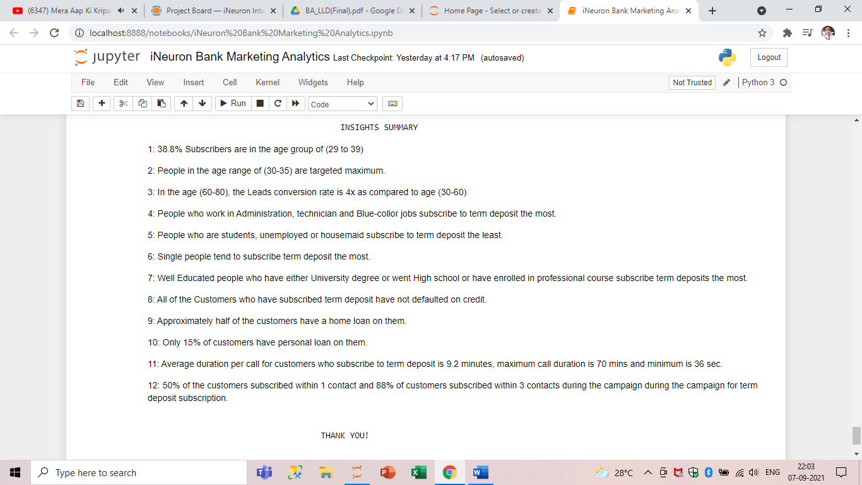
Insights summary:

Slide 9
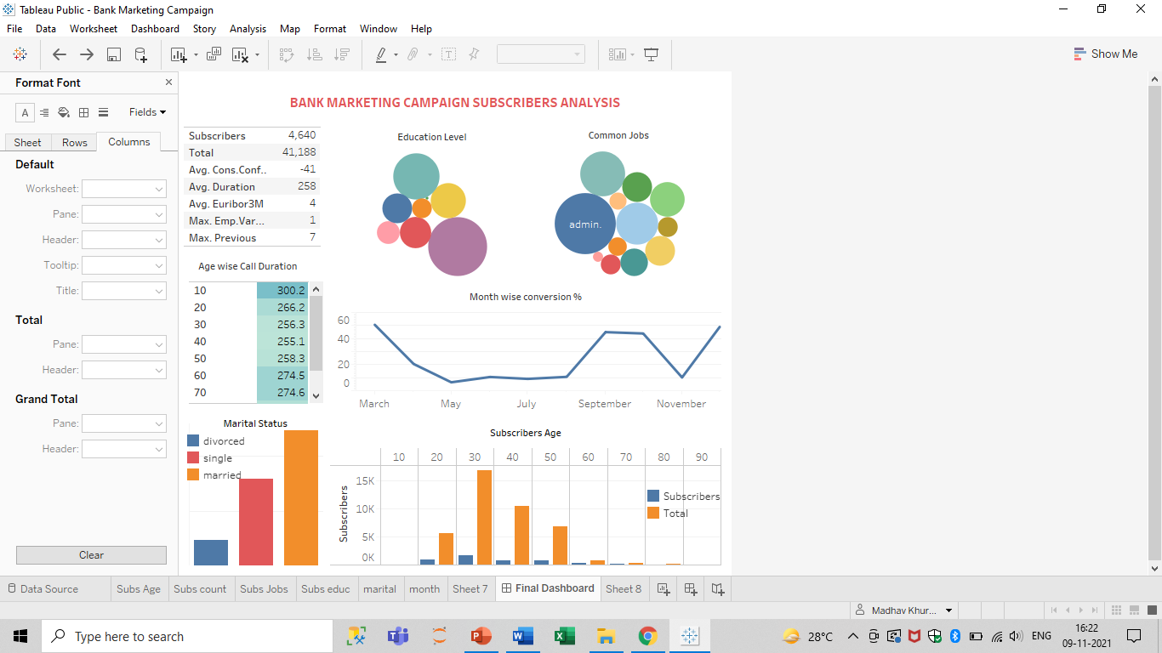

Slide 10
INSIGHTS FROM DASHBOARD
A total of 41188 people were called during the campaign out of which 4640 subscribed to the term deposit. So, the leads conversion rate of the campaign is 11.26%.
Call duration time for age group 60-90 is more as compared to age group 20-50 which indicates that younger customers need less time on call.
Out of 4640 customers, 53.3% of customers are married, 34% customers are single and 10% are divorced.
Many customers have a university degree or went to high school. Only 0.01% customers are illiterate.

Slide 11
Most common jobs of customers are in Administration, Blue-collar and Technicians. Very few number of customers are entrepreneurs or housemaid.
In the 5 month timeline of April to August, the leads conversion ratio is least.
The highest leads conversion ratio stood at 50.55% whereas lowest is 6.43%.
Maximum customers are in the age range of 20-60. Maximum people were called in the age range of 20-50. Hence, leads conversion rate of people of age range 50-60 is highest.
The lowest number of customers are age range of 80+. Usually, the people in the age range don’t have much time and earnings. So, they don’t invest in term deposit.
Average call duration of customers in 258 secs. Average consumer confidence index is -41 and Average Euribor 3m rate is 4.

Slide 12
Q & A:
Q1) What’s the source of data?
This dataset is publicly available for research. Available at: [pdf] http://dx.doi.org/10.1016/j.dss.2014.03.001 titled “Bank Marketing (with social/economic context)”
Q 2) What was the type of data?
The data was contained in the zip folder in csv format.
Q 3) What’s the complete flow you followed in this Project?
Refer slide $th for better Understanding
Q 4) What steps should I follow to get insights from the data?
Step1 – Download the data and store it in a location in your PC.
Step2 – Open .ipynb solution notebook, enter the path and run all cells.

Slide 13
Q5) Can I use different IDE to open Solution.ipynb?
Yes, this file is compatible to run in any IDE that supports python.
Q 6) What were the libraries that you used in Python?
I used Pandas, NumPy and Matplotlib libraries in Pandas.
Q 7) Do I have to download and import all these libraries?
These libraries are downloaded inbuild, So you don’t need to download separately. For importing these libraries, the code is already written.
Q 8) How much time will it take to run all cells in all cells and get insights?
It will usually take less than a minute to run and execute the solution file.

